Slide 1
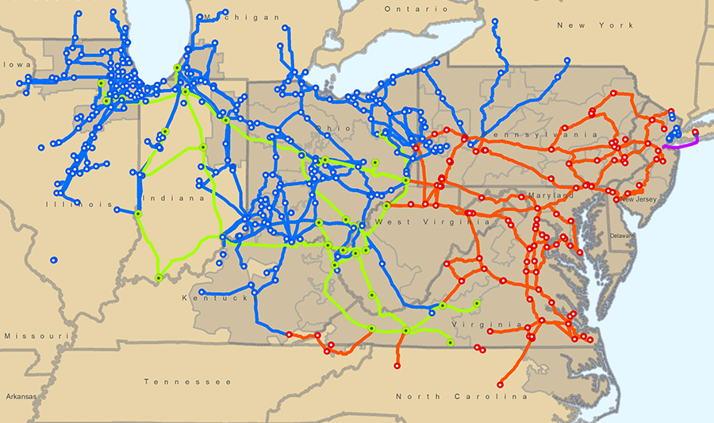
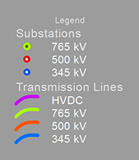
PJM Backbone Transmission

Slide 2
Electricity Demand Growth
Notes:
Molly Mooney
Jan. 27, 2026

Slide 3
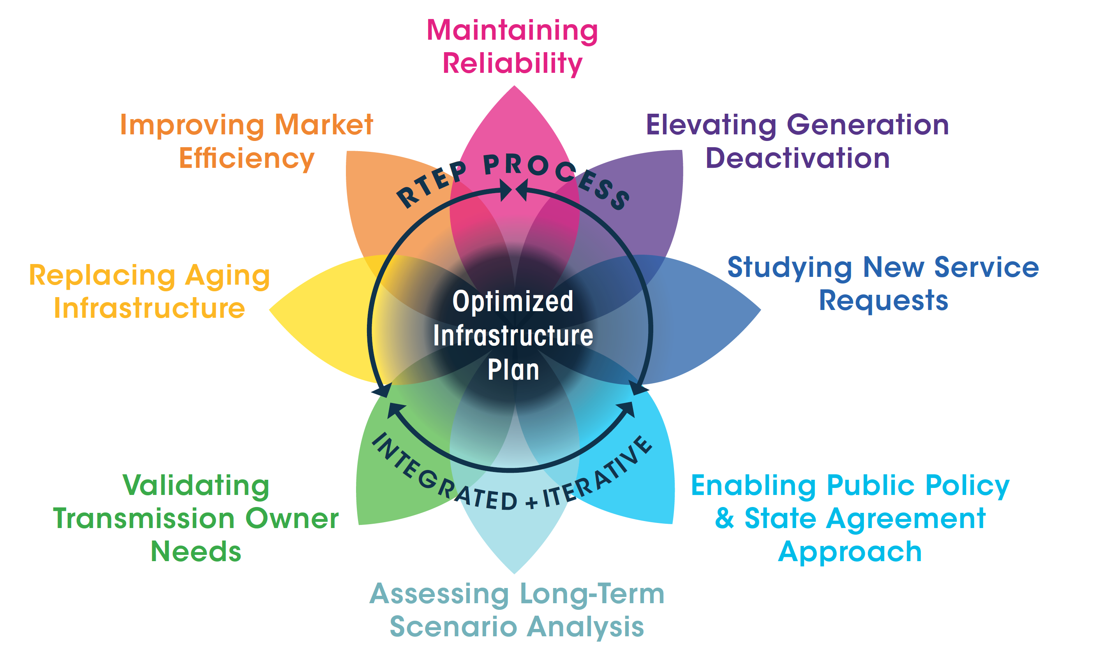
Optimizing Regional Transmission Infrastructure Investment
Notes:
Key Points for Brochure - Leveraging Planning Opportunities
Overview
PJM RTEP not summation of projects arising out of independent, siloed analyses. To the contrary.
Comprehensive, holistic RTEP Process:
1 Overlapping and interacting analytical processes.
2 Leveraging economy and efficiency through integrated, iterative analysis
3 Confluence of processes that yield one plan in the end.
PJM holistically leverages opportunities to develop more efficient solutions to RTEP baseline needs that can also solve needs driven by the following system needs:
Market efficiency
Generation Deactivation
Aging infrastructure
New Service Requests
Generation Interconnection
Merchant Transmission Interconnection
Long-term Firm Transmission Service
Transmission Owner M-3 Supplemental Need
Public Policy / State Agreement Approach
Long-term scenario analysis
How does PJM leverage opportunities for greater efficiency and economy in developing one holistic plan?
Baseline and Market efficiency Project Opportunities:
Determine which reliability-driven transmission projects, if any, provide an economic market efficiency benefit if accelerated or modified
Identify reliability-driven transmission projects already included in the RTEP that could be designed in a more robust manner in order to relieve one or more economic constraints or provide additional economic benefits.
Baseline Enhancements and New Service (e.g, Generation Interconnection) Project Opportunities
Identifies instances where increasing capability of an existing RTEP project obviate the need for a separate network upgrade driven by a generator interconnection request.
Customer pays only for incremental portion of the project.
Permits PJM to plan grid enhancements that benefit both load and interconnection customers.
Provides a New Services Customer with a complete system model by which to make informed business decisions based on new system capabilities using the most recent Board-approved RTEP grid enhancements
Interconnection customers are able to take advantage of remaining system capability (i.e., “headroom”) available on the transmission system before the need for customer-funded network upgrades are identified.
Baseline, Supplemental, and Customer-Funded Project Opportunities
During course of reviewing any prospective transmission projects, PJM works with stakeholders to identify instances where any or all elements of a given project interact electrically with those of any other:
Between a Supplemental Project during the Attachment M-3 Process and an existing Baseline Project,
After a Supplemental Project is included in the Local but not yet included in the RTEP base case; and,
After an RTEP project is included in the base case (in a prior RTEP cycle) and an identified Supplemental Project or Customer-Funded Upgrade interacts with the RTEP project.
Where an opportunity is identified project that would address a regional need, PJM, as regional planner, examines other violations identified as part of the baseline RTEP process in the electrical area and determines the more efficient or cost-effective enhancements and expansions to address overall need.
Opportunity to discuss the interaction with the relevant transmission owners and/or customer at the appropriate stakeholder forums: Transmission Expansion Advisory Committee (“TEAC”) or Subregional RTEP Committee.
If a Supplemental need identified in the Attachment M-3 Process interact with an existing, known reliability critera violation, system condition, economic constraint, or public policy requirement already publicly posted on PJM’s web site, PJM will provide notice of the potential interaction by posting the newly available information to the PJM website and provide notification to stakeholders.
PJM may determine whether to lengthen an open proposal window in order to permit project proposers additional time to consider the availability of new or changed information. PJM can consider proposals, including proposals in its open proposal window that more efficiently and cost-effectively address both the identified baseline need(s) and any related needs identified in the Attachment M-3 Process.
After PJM has had an opportunity for stakeholder review and comment, PJM determines the action to take depending on the point in the RTEP process in which the electrical interaction has been identified.

Slide 4
New Generation Projects Seek To Connect
Under PJM’s Reformed Process

